Slide 1
“Actively Engaged in the World”
Notes:
Good Morning, Afternoon, Evening
I want to share with you the Matthew 25 Invitation being issued by the Presbyterian Mission agency to all churches, mid-councils, groups and organizations of the Presbyterian Church USA.

Slide 2
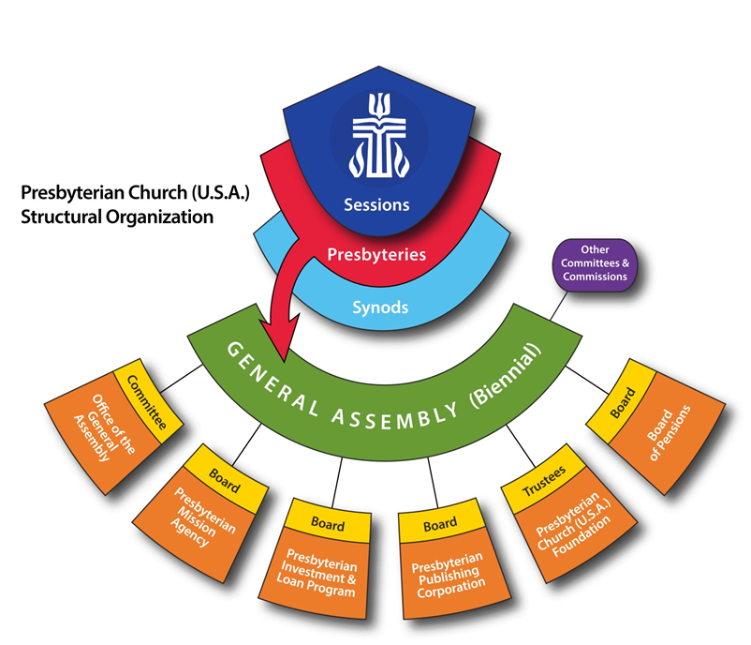

Slide 5
Scripture Reading
  Matthew 25:31-46 NRSV
Notes:
Let’s read these passages together.

Slide 6
Matthew 25:31-46 NRSV
31 “When the Son of Man comes in his glory, and all the angels with him, then he will sit on the throne of his glory. 32 All the nations will be gathered before him, and he will separate people one from another as a shepherd separates the sheep from the goats, 33 and he will put the sheep at his right hand and the goats at the left.

Slide 7
Matthew 25:31-46
34 Then the king will say to those at his right hand, ‘Come, you that are blessed by my Father, inherit the kingdom prepared for you from the foundation of the world; 35 for I was hungry and you gave me food, I was thirsty and you gave me something to drink, I was a stranger and you welcomed me, 36 I was naked and you gave me clothing, I was sick and you took care of me, I was in prison and you visited me.’

Slide 8
Matthew 25:31-46
37 Then the righteous will answer him, ‘Lord, when was it that we saw you hungry and gave you food, or thirsty and gave you something to drink? 38 And when was it that we saw you a stranger and welcomed you, or naked and gave you clothing? 39 And when was it that we saw you sick or in prison and visited you?’ 40 And the king will answer them, ‘Truly I tell you, just as you did it to one of the least of these who are members of my family, you did it to me.

Slide 9
Matthew 25:31-46
Then he will say to those at his left hand, ‘You that are accursed, depart from me into the eternal fire prepared for the devil and his angels; 42 for I was hungry and you gave me no food, I was thirsty and you gave me nothing to drink, 43 I was a stranger and you did not welcome me, naked and you did not give me clothing, sick and in prison and you did not visit me.’

Slide 10
Matthew 25:31-46
44 Then they also will answer, ‘Lord, when was it that we saw you hungry or thirsty or a stranger or naked or sick or in prison and did not take care of you?’ 45 Then he will answer them, ‘Truly I tell you, just as you did not do it to one of the least of these, you did not do it to me.’ 46 And these will go away into eternal punishment, but the righteous into eternal life.

Slide 11
A Special Blessing is Pronounced Upon People
When we serve, we are compelled to actively engage, we serve Jesus Christ!
Notes:
Jesus is calling us to put legs to love, feet to faith and hands to hope.

Slide 12
Matthew 25 – Foci
  Building Congregational Vitality
Notes:
Matthew 25 provides a sound biblical and theological basis for the Presbyterian Mission Agency’s 2019-2020 focus on
Building Congregational Vitality
Dismantling Structural Racism
Eradicating Systemic Poverty

Slide 13
Congregational Vitality
*Active Community Engagement
*Growing People in Christ
Notes:
Congregational Vitality is determined by faithfulness to the Gospel which is shaped by intentional growth in faith and practice or engagement of faith in community.
Vitality Not determined by the size of the congregation or budget
A question to test one’s vitality is who would miss your ministry besides the people who are now apart if you were to close your doors?
Vitality includes evangelism and church growth

Slide 14
Resources
Congregational Vitality Resources:
https://www.presbyterianmission.org/ministries/theology-formation-and-evangelism/vital-congregations/resources-from-the-office-of-vital-congregations/

Slide 15
Matthew 25 – Foci
  Dismantling Structural Racism
Notes:
Matthew 25 provides a sound biblical and theological basis for the Presbyterian Mission Agency’s 2019-2020 focus on
Building Congregational Vitality
Dismantling Structural Racism
Eradicating Systemic Poverty

Slide 16
Structural Racism/White Privilege
Laws, Policies & Practices that Structure, Reinforce and Perpetuate Discrimination, Bias, Prejudice and Oppression of “People of Color”
Notes:
Structural racism moves beyond micro-aggressions and individual behavior to systems.
“All Privileged groups, they believed they deserved their riches and advantages, no matter how brutally the original wealth and power might have been accrued….”Nicholas Sparks – Every Breath, pg22
White Privilege – How Europeans benefit from the practices designed to promote them over and against people of color

Slide 17
Resources
Anti-Racism Resources:
https://facing-racism.pcusa.org/

Slide 18
Matthew 25 – Foci
  Eradicating Systemic Poverty
Notes:
Matthew 25 provides a sound biblical and theological basis for the Presbyterian Mission Agency’s 2019-2020 focus on
Building Congregational Vitality
Dismantling Structural Racism
Eradicating Systemic Poverty

Slide 19
Systemic Poverty
The Economic Exploitation of People who are Impoverished through Laws, Policies, Practices & Systems that Perpetuate an Impoverished Status
Notes:
Systemic poverty requires that we not only be compassionate, but we deal with the issues the create the need for compassion.
“If one fish rolls up on the shore you say, what’s wrong with the fish– if a school of fish shows up on the shore you ask, what is wrong with the water?”
We want to change the water, so the fish can swim free.

Slide 20
Resources
Eradicating Systemic Poverty
https://www.presbyterianmission.org/ministries/compassion-peace-justice/

Slide 21
Matthew 25 – Foci
  Used as lenses on how we view our ministry:
  How does the work of World Mission help to Build Congregational Vitality?
  Can Presbyterian Disaster Assistance help in Dismantling Structural Racism?
  What can Peaks Presbytery do to Eradicate Systemic Poverty?
Notes:
Matthew 25 provides a sound biblical and theological basis for the Presbyterian Mission Agency’s 2019-2020 focus on
Building Congregational Vitality
Dismantling Structural Racism
Eradicating Systemic Poverty

Slide 22
Matthew 25 - Purpose
Connect and unite the PC(USA)
Celebrate and call forth
Clarify the self-understanding of Christians in the PC(USA)
Notes:
By accepting the Matthew 25 invitation, you can help our denomination become a more relevant presence in the world by
• Connecting and uniting the PC(USA), creating a spark that energizes and joins us in our common mission together
• Celebrating and calling forth churches that actively engage the world
• Showing our understanding as Presbyterian Christians that we are “saved to serve”

Slide 23
Why Statement
“We believe God calls us to act boldly and compassionately so that faith comes alive and the world wakes up to new possibilities.”
Notes:
The Mission Agency Leadership Cabinet worked together to identify their why statement.
As John’s Gospel tells us, “New possibilities—new ways of living together so that all people have the opportunity to live to the fullest.” John 10:10

Slide 24
The Invitation
We invite you to join us
on this journey by choosing to become a
Matthew 25 church.
Notes:
Matthew 25 is a living translation of Jesus Christ - strengthening relationships, transforming your church, and bringing alive your commitment to “serve the least of these” in your community and around the world.

